Slide 1

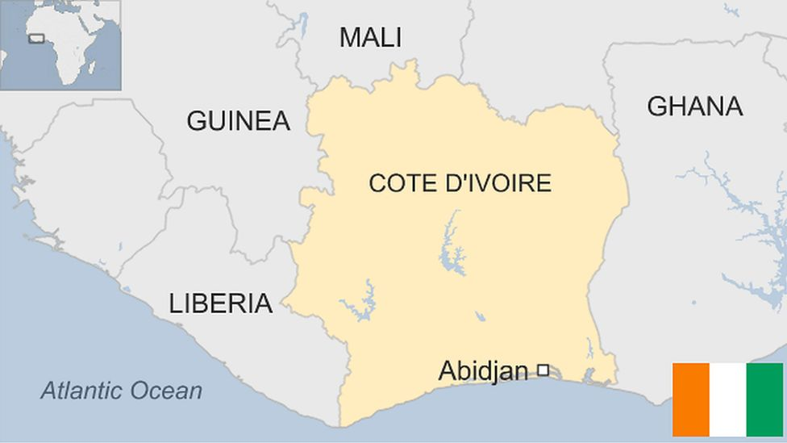
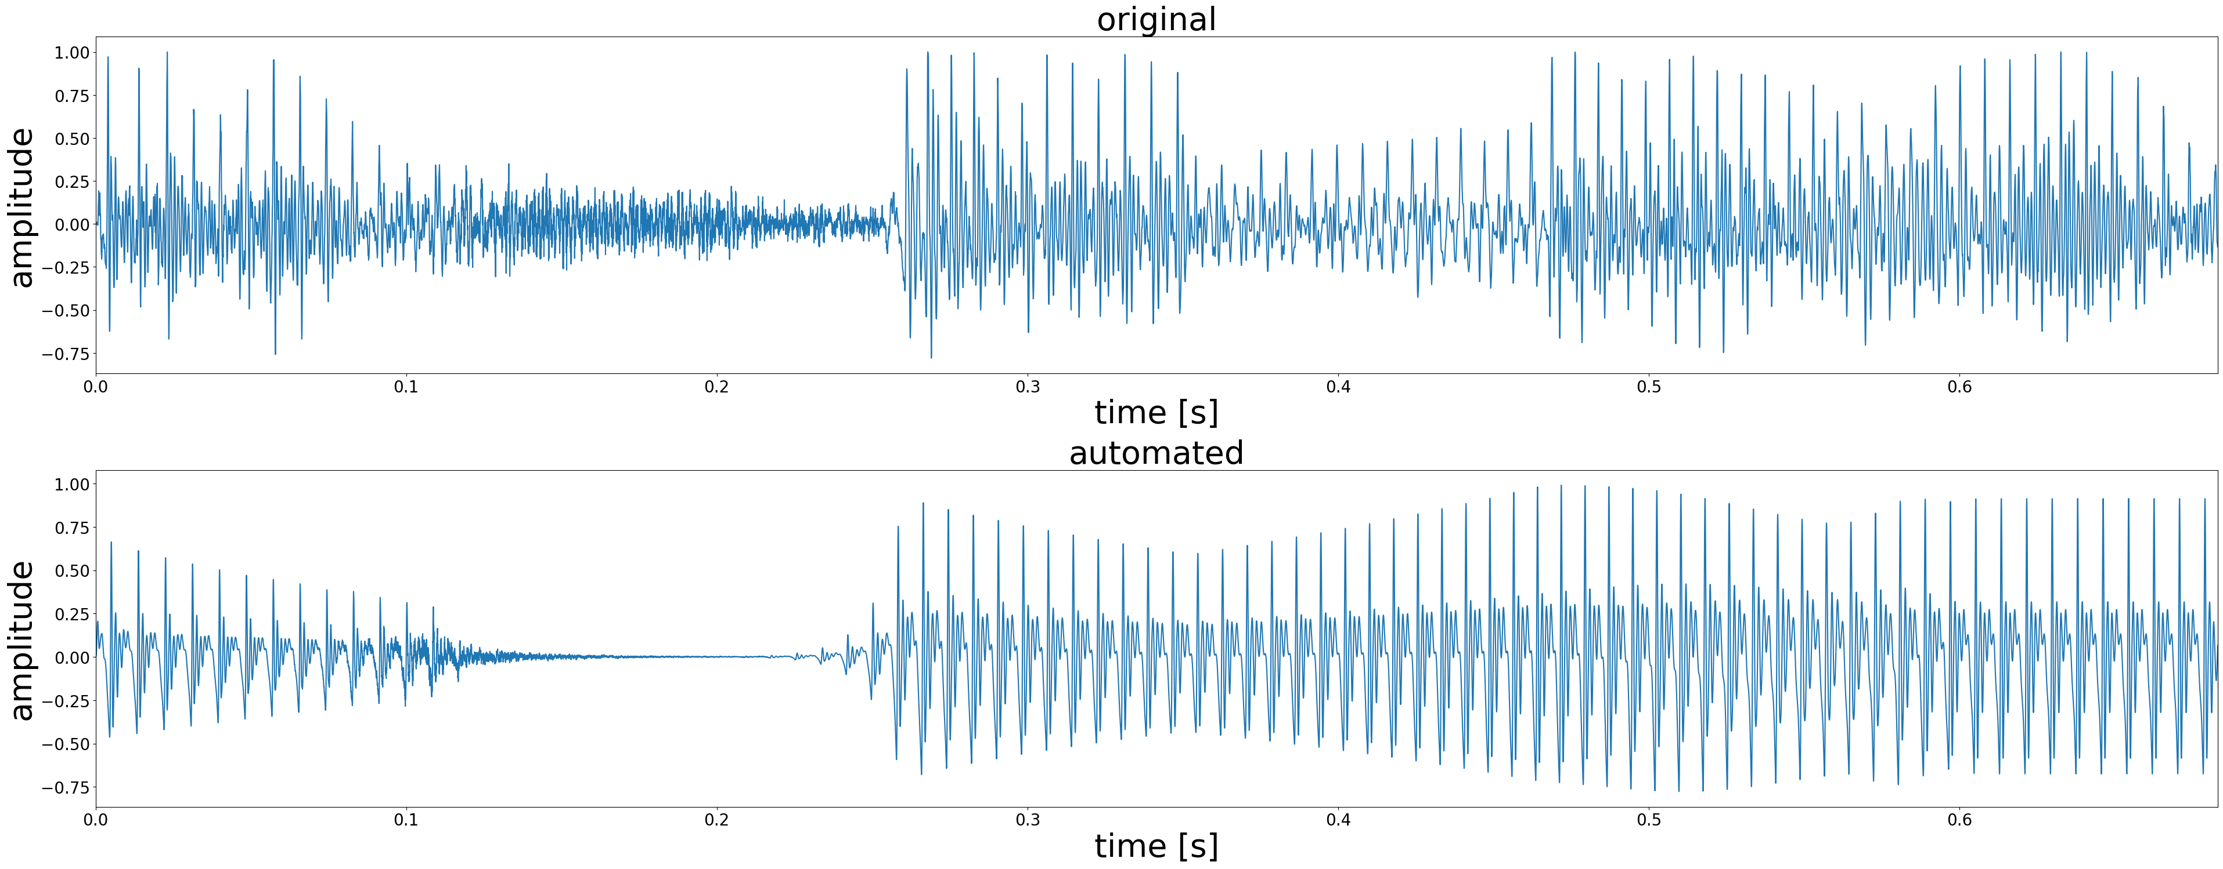
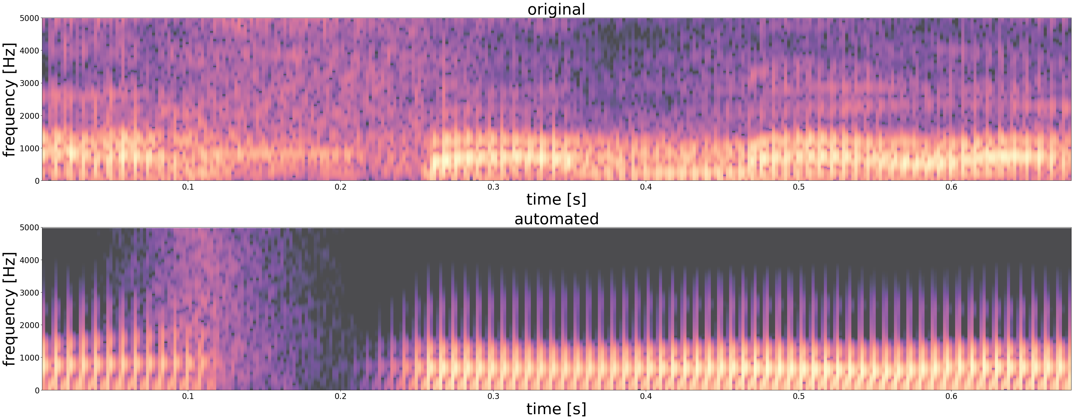
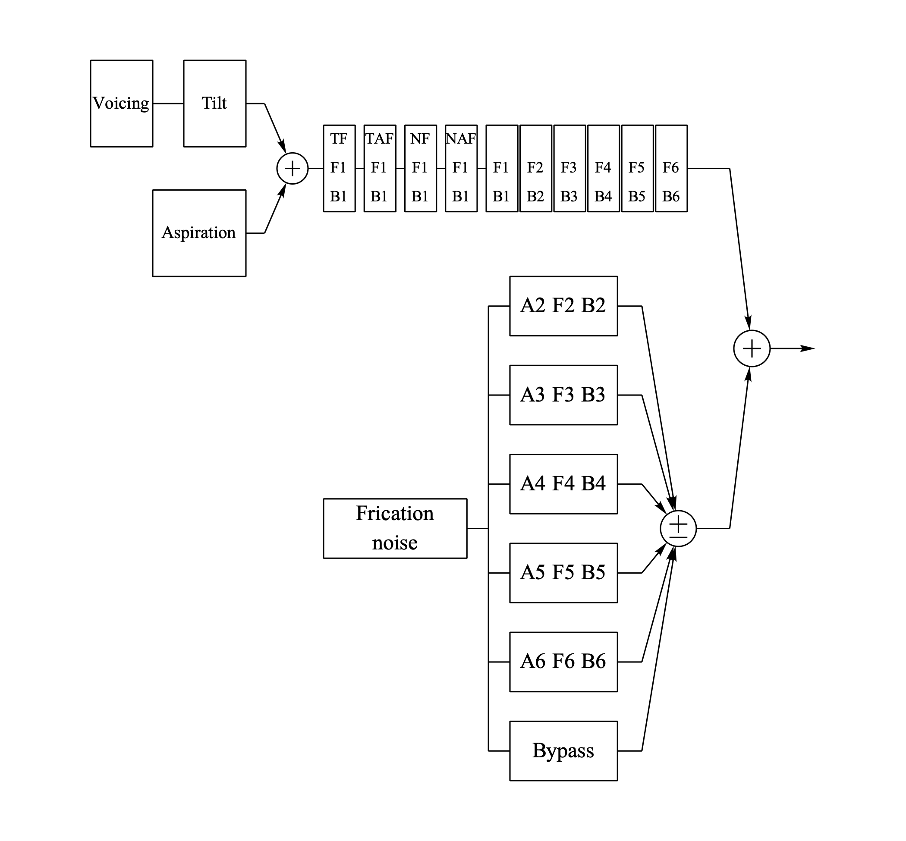
Reconstructing Speech from Pitch, Formant, and Intensity Data
Jake Haapoja and Hannah Loukusa, St. Cloud State University
Faculty Sponsors: Dr. Ettien Koffi and Dr. Mark Petzold
Background Information
- Betine language of Ivory Coast (Fig. 1) is endangered
- Goal of project of Dr. Koffi and Dr. Petzold:
Create a Siri-like system for Betine to preserve as much
of the language as possible
Methods
Manual Phoneme Separation
- PRAAT TextGrid was created, and boundaries were placed manually between phonemes.
Automated Feature Extraction
- PRAAT scripts were used to extract pitch, formant, and intensity averages for each phoneme.
KlattGrid Construction
- The averages for each phoneme were used to create points in the KlattGrid object (Fig. 4).
.
Figure 1. Betine is spoken in the Ivory Coast
Class Project Definition
- Extract pitch, formant, and intensity data from sound file of the name /asamala/ in Betine
- Produce a KlattGrid to reconstruct the name in a sound file that sounds natural
Results
- The audio was successfully approximated, and the produced audio was understandable, despite being stiff and robotic (Fig. 2 and 3).
Figure 2. comparison of waveforms between the original (top) and the synthesized (bottom) audio
Figure 3. comparison of spectrograms between the original (top) and synthesized (bottom) audio
Conclusion
- Language reproduction systems can be constructed from minimal recorded data automatically and efficiently with minimal annotation from the researcher.
- Future research may focus on automatic interval alignment and building a repository of Betine Phonemes for arbitrary word generation
Figure 4. KlattGrid synthesizer
References
[1] Dennis H. Klatt & L C Klatt. 1990. Analysis, synthesis, and perception of voice quality variations among female and male talkers. The Journal of the Acoustical Society of America. Vol. 87, 2, 820-57, 1990
[2] Hale, Krauss. 1992. Language Endangerment and the Human Value of Linguistic Diversity. Language 68 (1) 35-42.
[3] Koffi, Ettien & Petzold, Mark. (2022). A Tutorial on Formant-Based Speech Synthesis for the Documentation of Critically Endangered Languages. Volume 11. 26-55.
[4] “Ivory Coast Country Profile.” BBC. https://www.bbc.com/news/world-africa-13287216

